Slide 1
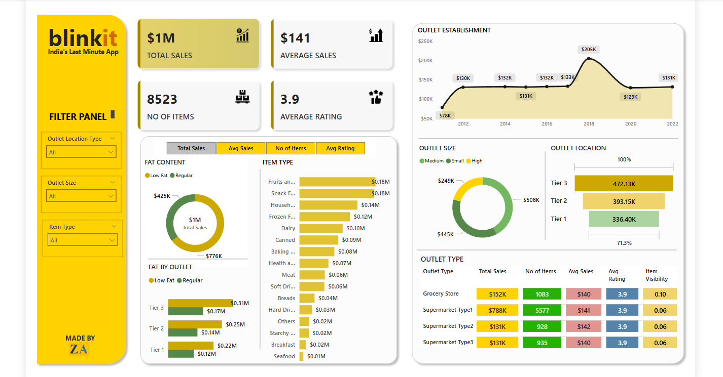
Blinkit Analysis

Slide 2
STEPS IN PROJECT
Requirement Gathering/Business Requirement
Data Collection
Data Walkthrough
Data Cleaning
Data Modelling
Data Processing
DAX Calculation
Chart Development and Formatting

Slide 3
BUSINESS REQUIREMENTS
To conduct a comprehensive analysis of Blinkit Sales performance, Customer satisfaction, and Inventory distribution to Identify key insights and opportunities using various KPI’s and visualization tools
KPI’s Requirements
1. Total Sales 2. Average Sales
3. No of Items
4. Average Rating

Slide 4
BUSINESS REQUIREMENTS
Chart’s Requirements
Total Sales By Fat Content :
Objective – Analyse the Impact of Fat content on Total Sales
Additional KPI Metrix – Access how other KPI’s(Average Sales, No. of Sales, Average rating) vary with fat content
2. Total Sales By Item Type :
Objective – Identify the performance of different Item types in terms of total sales
Additional KPI Metrix – Access how other KPI’s(Average Sales, No. of Sales, Average rating) vary with fat content
3. Fat Content By Outlet of Total Sales :
Objective – Compare total sales across different outlet segmented by fat content
Additional KPI Metrix – Access how other KPI’s(Average Sales, No. of Sales, Average rating) vary with fat content

Slide 5
BUSINESS REQUIREMENTS
Chart’s Requirements
4. Total Sales By Outlet Establishment :
Objective – Evaluate how the Age or type of Outlet establishment influences total sales
5. Sales By Outlet Size :
Objective – Analyse the correlation between outlet size and total sales
6. Sales By Outlet :
Objective – Access the geographical distribution of sales across different location
7. All Metrics By Outlet Types :
Objective – Provide a comprehensive key metrics(Total Sales, Avg Sales, No of Items , Avg Rating

Slide 6
Key Insights from the Dashboard Analysis
Fat Content Analysis:
Total sales Low-Fat products surpass Regular Fat products by 65%, indicating a strong consumer preference.
When considering average sales, both Regular Fat (51%) and Low Fat (49%) are consumed almost equally.
In terms of the number of items sold, Low Fat products dominate.
The average rating for both categories remains the same at 3.9, suggesting similar customer satisfaction levels.
2. Fat Content by Outlet Location:
Low Fat products have the highest sales in Tier 3 cities, while sales are lowest in Tier 1 cities.
The total number of items sold is higher for both Low Fat and Regular Fat categories, emphasizing their market demand.

Slide 7
Key Insights from the Dashboard Analysis
3. Top & Bottom Product Categories:
The top three highest-selling categories are:
Fruits & Vegetables
Snack Foods
Household Items
The bottom three least-selling categories are:
Seafood
Breakfast Items & Starchy Foods
Hard Drinks
4. Outlet Establishment Year & Sales Trend:
When the business was first established, sales were relatively low at $78K.
From 2012 to 2017, sales remained stable at approximately $132K per year.
A significant increase in sales occurred in 2018, reaching $205K, marking a positive growth trend.

Slide 8
Key Insights from the Dashboard Analysis
5. Sales by Outlet Size:
Medium-sized outlets generate the highest sales, totaling $508K.
Small outlets also perform well, with $445K in sales.
High-sized outlets have the lowest sales at $249K, suggesting they may benefit from restructuring into smaller or medium-sized formats for better cost efficiency.
Outlet Type Performance:
Among all outlet types, Supermarket Type 1 has the highest total sales, highlighting its strong market presence and consumer preference.

